Slide 1
IT Project
Management
(Introduction to Microsoft Project 2)
Instructor: Tran Vinh Khiem
March 1st, 2020
S³T
Smart Software System Team

Slide 2

“Being a Project Manager is like being an artist, you have the different colored process streams combining into a work of art.”
– Greg Cimmarrusti
IT Project Management

Slide 3
Learning Objectives
Understand the basic structure of Microsoft Project 2019
Know how to use MS Project on resource management.
Make resource, grant chart.

Slide 4
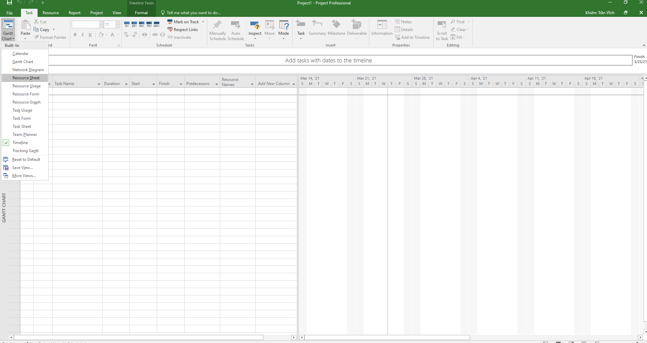
Resource management
Gantt chart → Resource Sheet

Slide 5
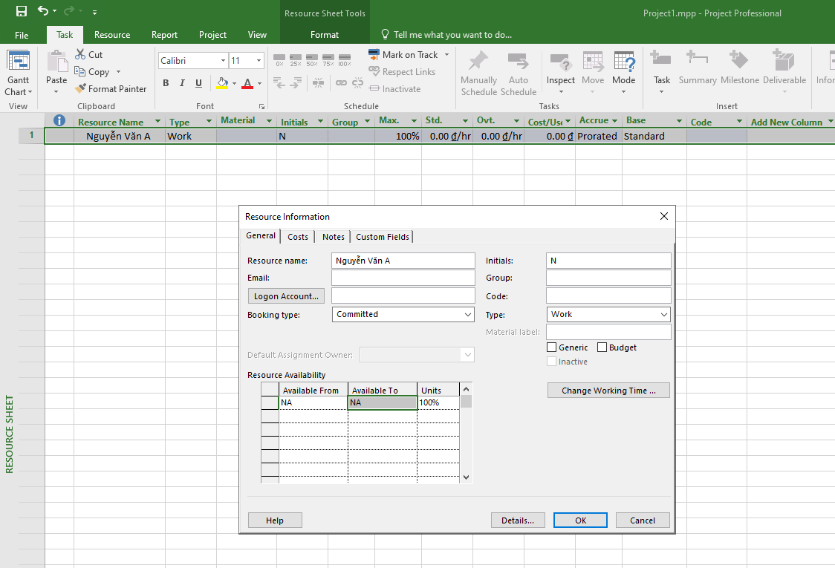
Resource management
Input Resource Name, Type (Work, Material, Cost),…

Slide 6
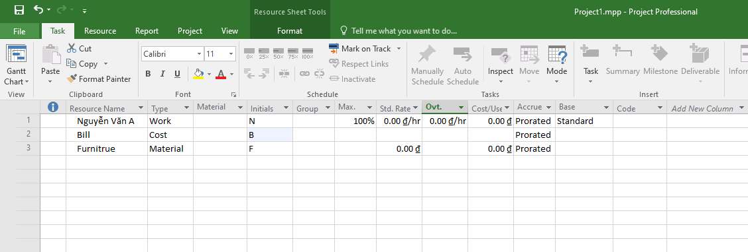
Resource Management
Max. is only with human resource
Cost type has only accuracy at feature.

Slide 7
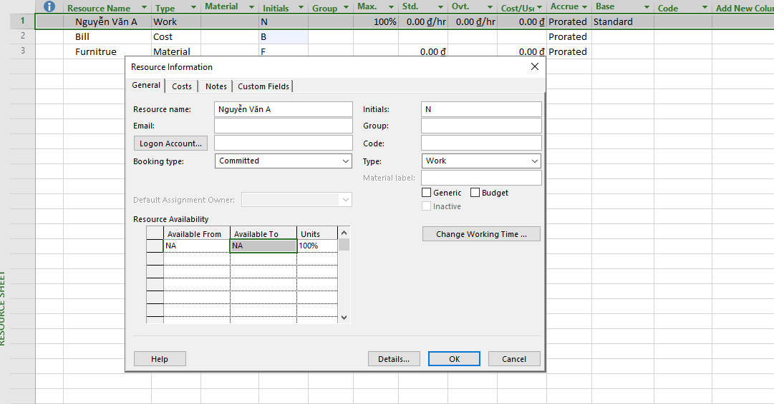
Resource Information
Double click on Resource Name and edit what information needs

Slide 8
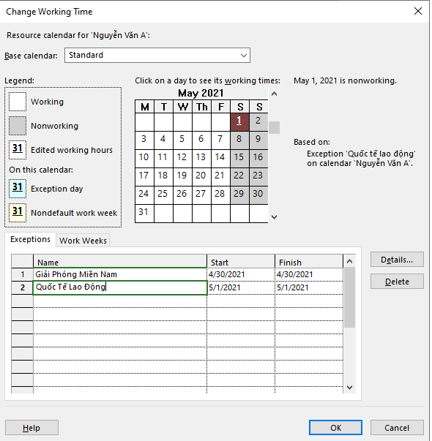
Resource Information
Click on change Working Time, choose date on calendar and change Name.

Slide 9
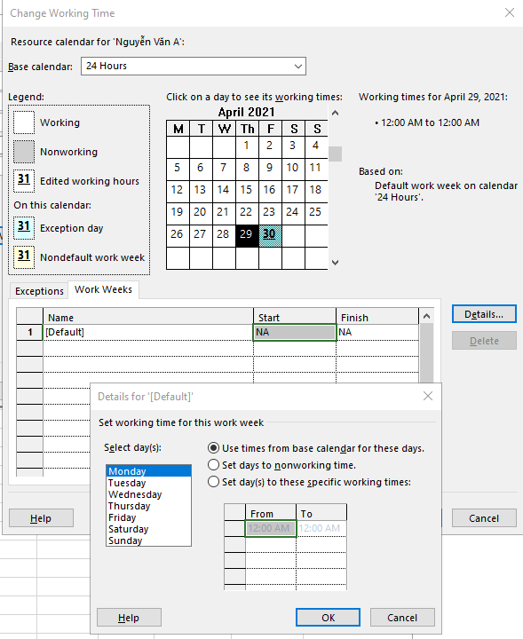
Resource Information
Click on Work Weeks, choose default and click on details to edit working time on specific date.

Slide 10
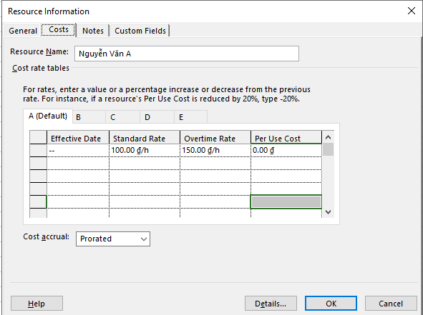
Resource Cost
Back to Resource Information → choose Cost → Edit Standard Rate for normal cost, Overtime rate for overtime working cost.

Slide 11
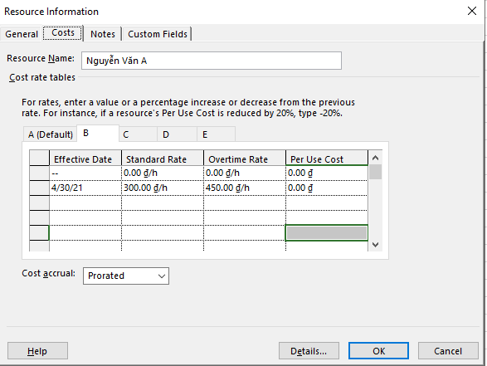
Resource Cost
Click on other tab (B,C,…)→ Edit Effective Date → Choose specific date and edit Rate. For example, 30/4 is Special day, salary must be different.

Slide 12
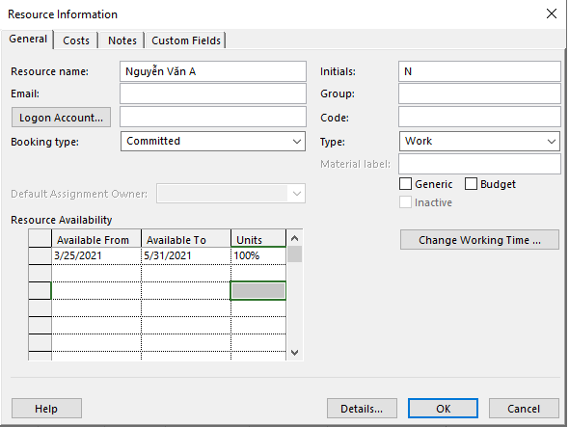
Resource Availability
Come back to General → Edit Resource Availability to edit the progress time that this resource can be used.

Slide 13
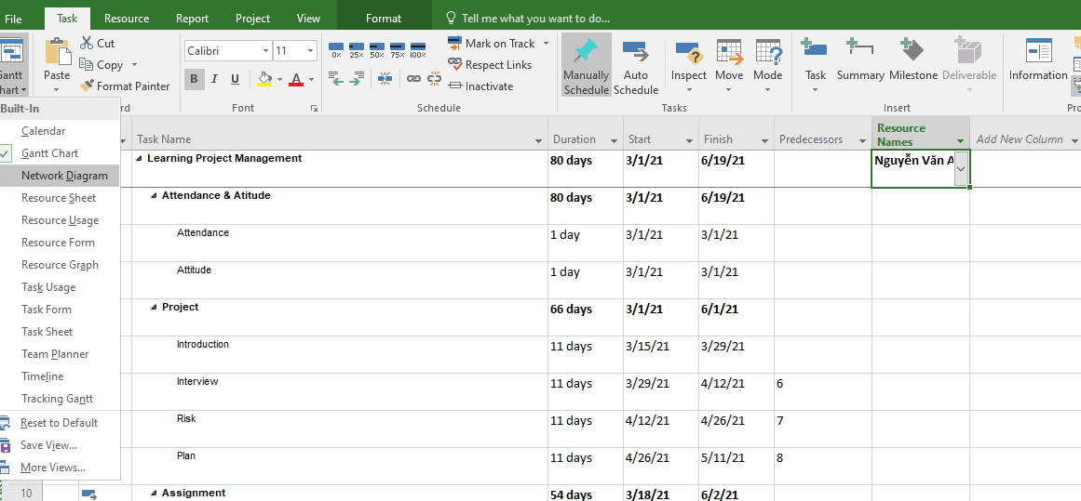
Resource Assignment
Come back to Gantt Chart → Choose Resource Name → Assign to people needs on this project.

Slide 14
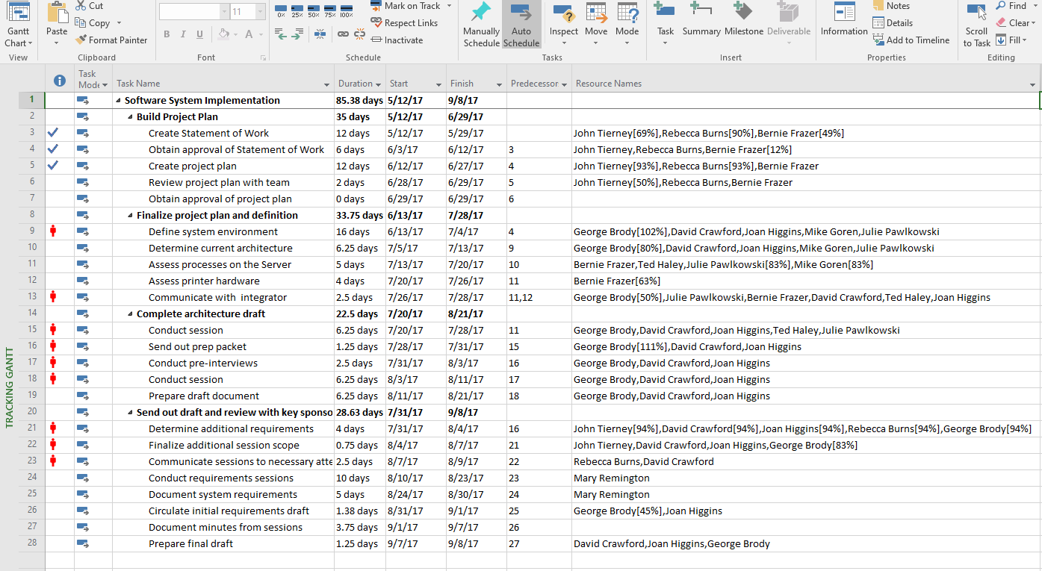
Exercise 1
Open Exercise 6 on Lab 1, Create and assign resource as below:

Slide 15
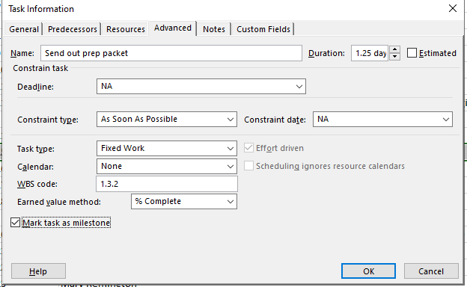
Milestone
Make task as milestone: Click on Task → Task information → Advanced → Make task as milestone

Slide 16
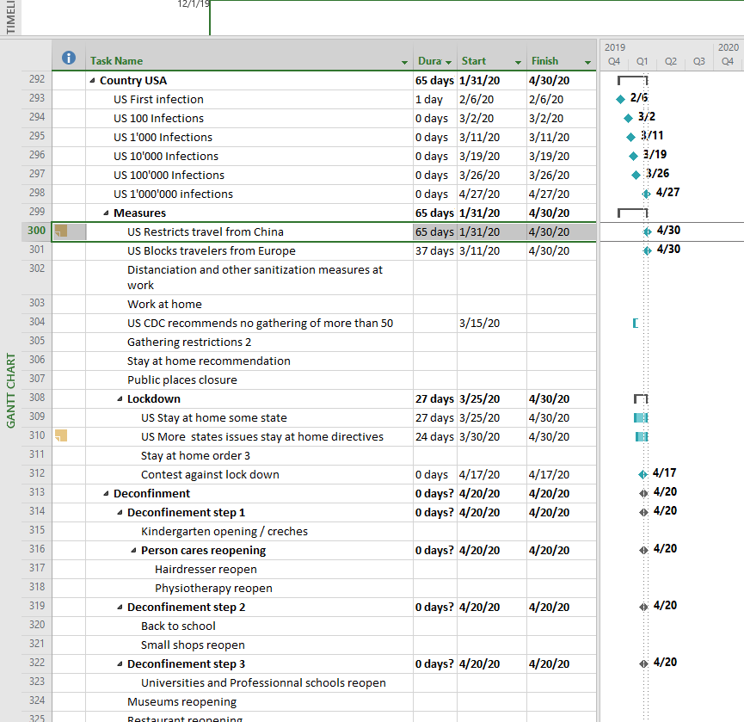
Exercise 2
Create milestones as below based on Exercise 3 – Lab 1.

Slide 17
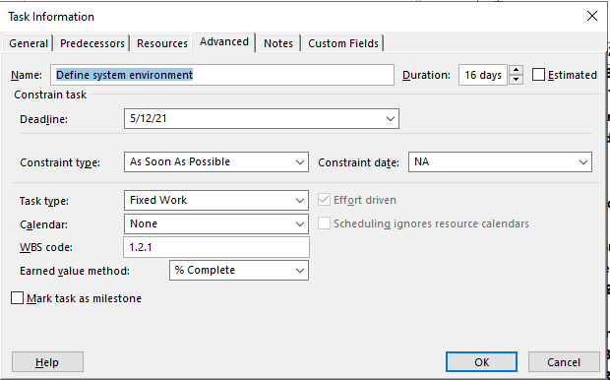
Deadline
On task information → Choose Advanced → Set deadline. Some tasks you must set deadline before the finish date.

Slide 18
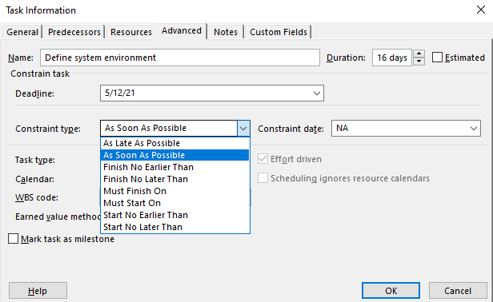
Constraints
On task information → Choose Advanced → Set Constraints type. Some tasks you must set deadline before the finish date.

Slide 19
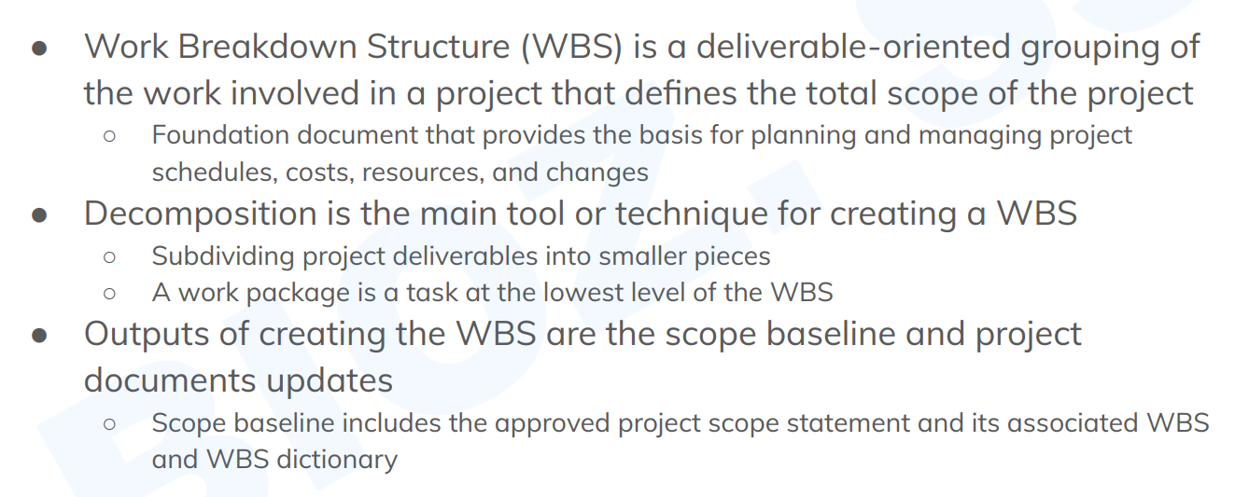
WBS (Work Breakdown Structure)

Slide 20
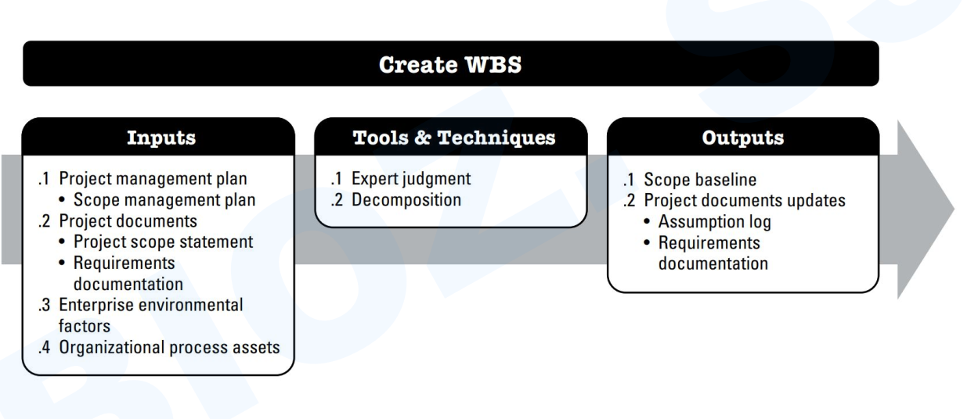
WBS (Work Breakdown Structure)

Slide 21
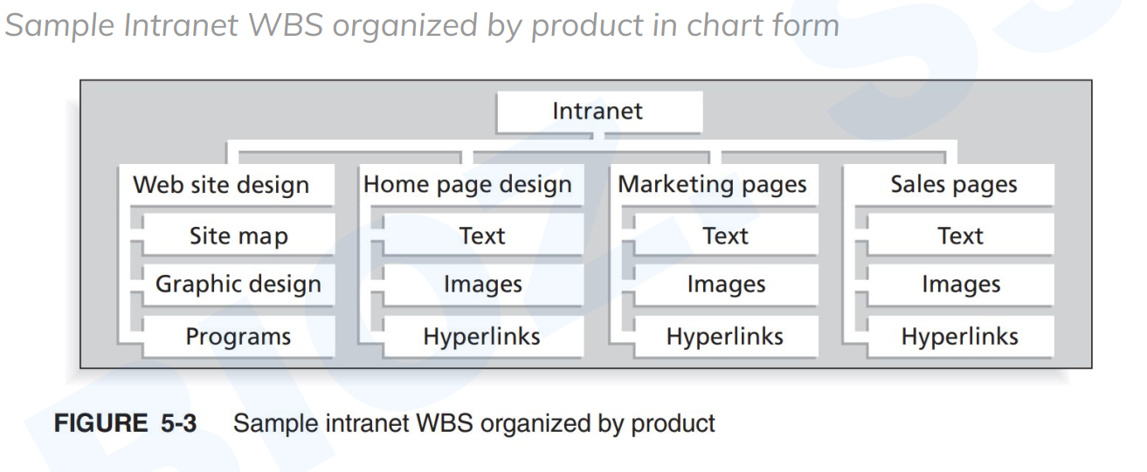
WBS (Work Breakdown Structure)

Slide 22
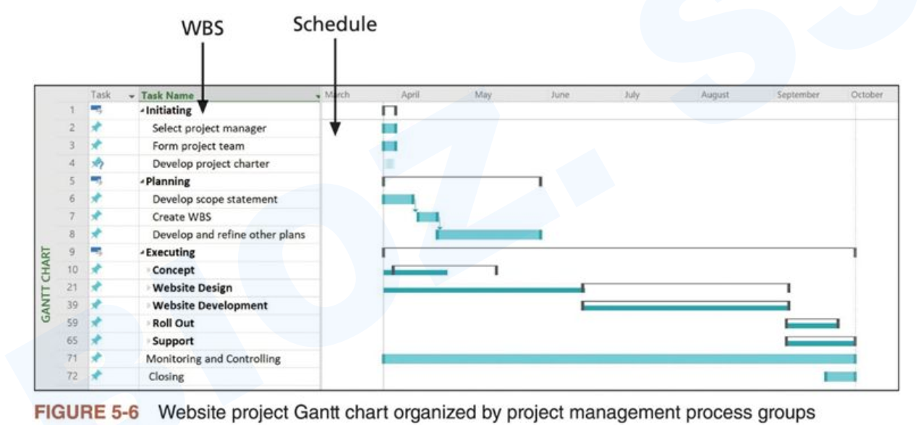
WBS (Work Breakdown Structure)

Slide 23
Exercise 3
Convert MS Project WBS below to the chart form.

Slide 24
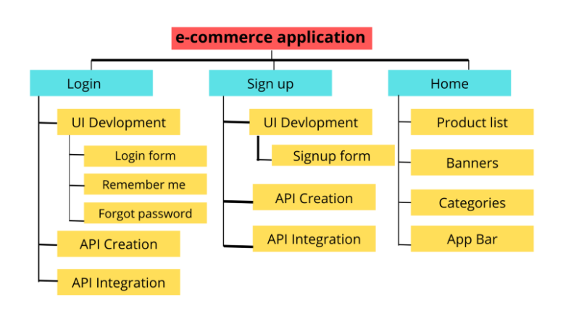
Exercise 4
Convert chart form below to the MS Project WBS.

Slide 25
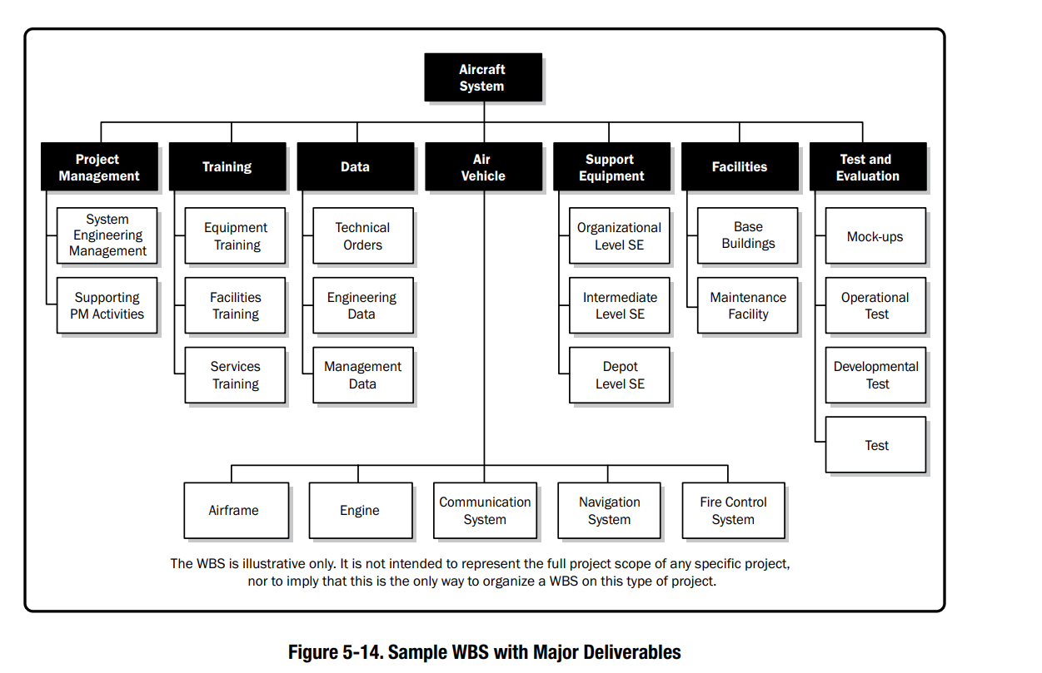
Exercise 5
Draw this WBS Chart form and convert it into MS Project WBS

Slide 26
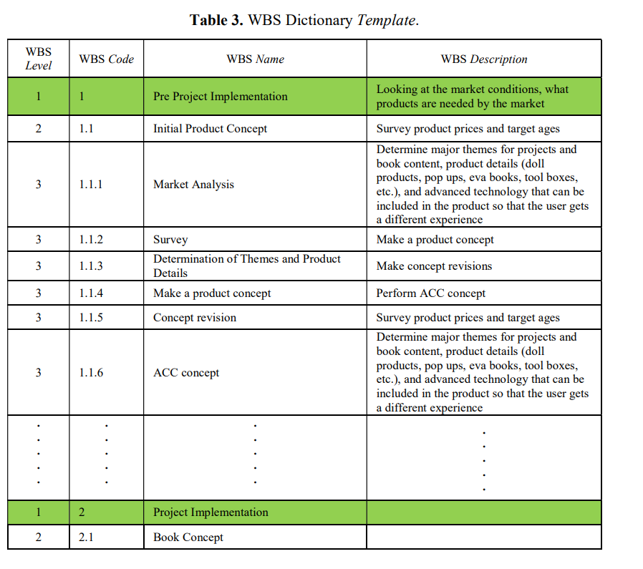
Exercise 6
Create WBS Dictionary of Exercise 3 as this format.
Notes:
Fitri, N., Pratami, D. and Tripiawan, W., 2019, July. Project Baseline Design for Scope, Time, and Cost Aspect in Putri Provinsi Multi Set Toys Book Project PT XYZ Bandung. In 5th Bandung Creative Movement International Conference on Creative Industries 2018 (5th BCM 2018) (pp. 383-390). Atlantis Press.

Slide 27
Q & A
Thank you for attention
“Coming together is a beginning;
Keeping together is progress;
Working together is success.”
- HENRY FORD

